Slide 1


Introduction to Git and GitHub
Noel Mc Grath
https://github.com/noelmcgrath/GitPresentation

Slide 2
Agenda
Day 1
Day 2
Getting to know Git
Working with Git locally
Git integration
Git Gui
Visual Studio Tools for Git
Git and TFS
Git and Multimedia
Recap
Working with Git remotely
GitHub
GitHub for Windows
Branching and Merging
Git internals
Resources

Slide 3
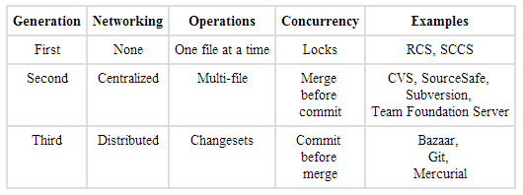
History of Version Control Systems
http://www.ericsink.com/vcbe/html/history_of_version_control.html

Slide 4
Why Use Version Control?
Lecturers
Students
Used in the industry
Software evolution
Track individual and group projects
Not just software
Preparing for work
Sharing and collaboration
Workflow
Rollbacks

Slide 5
Distributed Version Control Systems (DVCS for short)
Full history on local repository
You commit changes to your own repository
The owner of the official repository can pull those changes
Can have a centralised repository that all contributors can push to
Branching/merging reliable and easy
Backups are easy – each clone is a full backup
Deployments - heroku
Notes:
Draw difference between central and distributed

Slide 6
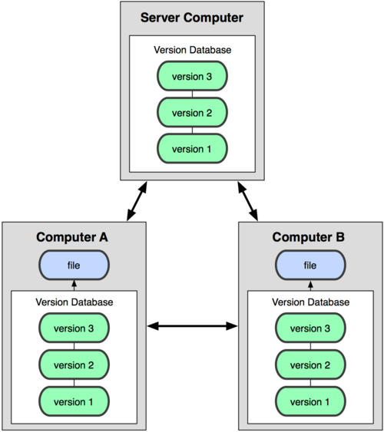

Centralized Versus Distributed Version Control Systems
Notes:
Draw difference between central and distributed

Slide 7
Git
Created by Linus Torvalds for Linux kernel development in 2005
Linux fell out with BitKeeper
Free and open source
Runs on many OS’s
Handle small to large projects
Fast performance
Cheap local branching
Simplicity

Slide 8
Command Line or GUI?
GUI and IDE options
Git Gui
TortoiseGit
Git Extensions
SourceTree
Visual Studio Tools for Git
GitHub on Windows
posh-git
Egit – Eclipse
Many more …..

Slide 9
Installation On Windows
http://msysgit.github.io/
Configure Git
Levels
System
User
Repository

Slide 10
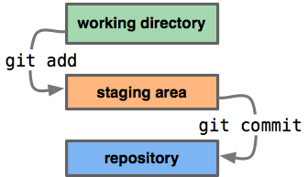
Our First Repository
Creating a repository
Adding files and committing
Making changes and diffs
Viewing history
Refactoring and viewing diffs
Ignoring files using .gitignore
Demo

Slide 11
Common Git Commands
Task | Command
Create repository | git init
Add file(s) | git add <filename> git add .
Commit changes | git commit -m "Commit message"
Check status | git status
View history | git log git log -10 git log --name-only
View changes | git diff git diff <sha1> <sha2>
Undo changes | git checkout .

Slide 12
Git and Team Foundation Server (TFS)
Team Foundation Server (TFS) isn't just source control, it's a whole bug tracking, change management, application lifecycle management (ALM) suite. Source control is one pluggable piece.
Support for Git since Visual Studio 2012 Update 3
http://visualstudiogallery.msdn.microsoft.com/abafc7d6-dcaa-40f4-8a5e-d6724bdb980c
Git available by default in Visual Studio 2013

Slide 13
Git and multimedia files
Not designed for this
Inefficient as wont do incremental diffs for binary files
Use other tools
git-annex
perforce
commercial products

Slide 14
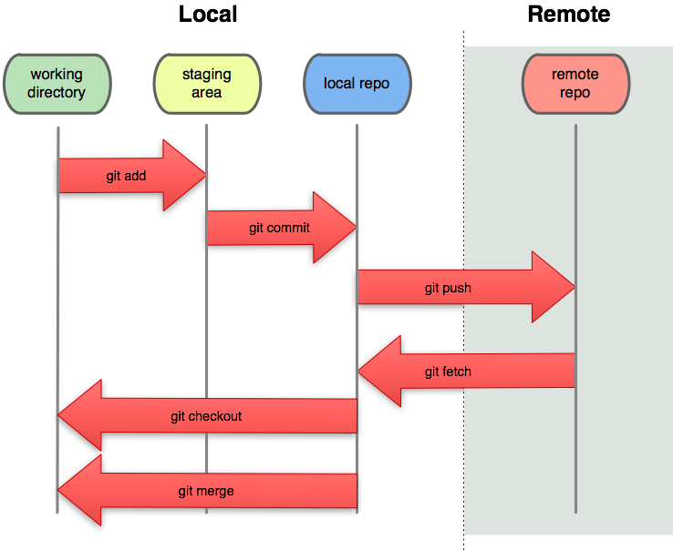
Working With Remote Repository
Cloning
Listing repositories
Fetching and Merging
Pulling
Pushing changes
Tags
Demo

Slide 15
More Git Commands
Task | Command
Clone a repository | git clone <repository url>
View history | git log –graph git shortlog
Show changes | git show <sha>
Show remote repository | git remote git remote -v
Add remote | git remote add origin <repository url>
Push changes to remote | git push git push origin master
Pull changes to remote | git pull git pull origin master
List branches | git branch
Create branch | git checkout -b <branchname>
Switch to branch | git checkout <branchname>

Slide 16
Branching and Merging
Local branches
Stashing changes
Merging branches
Remote branches

Slide 17
GitHub
Git repository hosting service – not just software
Largest code host on the planet with over 12.6 million repositories
Free accounts for public repositories
Paid plans for private repositories
Provides access control and several collaboration features
“forking” functionality
Notes:
Features – wiki, task management, graphs, code review etc

Slide 18
Git internals
TODO

Slide 19
Resources
Pro Git
http://git-scm.com/book
GIT IMMERSION
http://gitimmersion.com/lab_01.html
git ready
http://gitready.com
Linus Torvalds on git
https://www.youtube.com/watch?v=4XpnKHJAok8
Search

